Slide 1

OPINION MINING AND SENTIMENT ANALYSIS ON SOCIAL MEDIA
Guide
MRS.M PARVATHI ASSISTANT PROFESSOR
GOURAV PATIL(22P65A6606)
NAMITHA REDDY(21P61A66F9)
V.SRINU(21P61A66I0)

Slide 2
CONTENT
ABSTRACT
EXISTING SYSTEM
LITERATURE SURVEY
PROPOSED SYSTEM
SYSTEM REQUIREMENTS
SYSTEM ARCHITECTURE
UML DIAGRAMS

Slide 3
ABSTRACT
Sentiment analysis on social media is a natural language processing technique used to extract subjective information and opinions from user-generated content on various social media platforms, such as Twitter, Facebook, and Instagram. The goal of this project is to perform sentiment analysis on social media data related to a particular topic or brand, such as a product launch or a social issue. Social media data will be collected using relevant APIs or web scraping tools and preprocessed by cleaning and filtering out irrelevant or spammy content. A sentiment analysis model, such as a lexicon-based or machine learning model, will be applied to classify the sentiment of the content as positive, negative, or neutral. Results will be visualized and analyzed using various techniques and tools, such as word clouds, bar charts, and time series analysis, to gain insights and make data-driven decisions based on public opinion. Challenges in social media sentiment analysis include the use of slang, emojis, and hashtags, as well as the need to handle multilingual content. Sentiment analysis on social media can be a powerful tool for understanding public opinion, customer satisfaction, and brand reputation, and making data-driven decisions in various domains, such as marketing, politics, and social sciences.
Keywords : Filtering, Machine learning, Decision Tree Natural Language Processing(NLP), Sentiment, Social Media, Visual Studio Code, Jupyter.

Slide 4
EXISTING SYSTEMS
The people view that posted topic and may comment their opinion about the posted topic.
The person who posted the topic need to view all the comments posted by the users to take a decision or to know about the review of that posted topic.
This process may take more time.
DRAWBACKS
Dependence on Textual Comments.
Accuracy of Sentimental Analysis may not be same for all time.
Cannot know the correct review about topic/product.
Takes longer time to read all the reviews.
Owner cannot get accurate idea about user’s reviews.

Slide 5
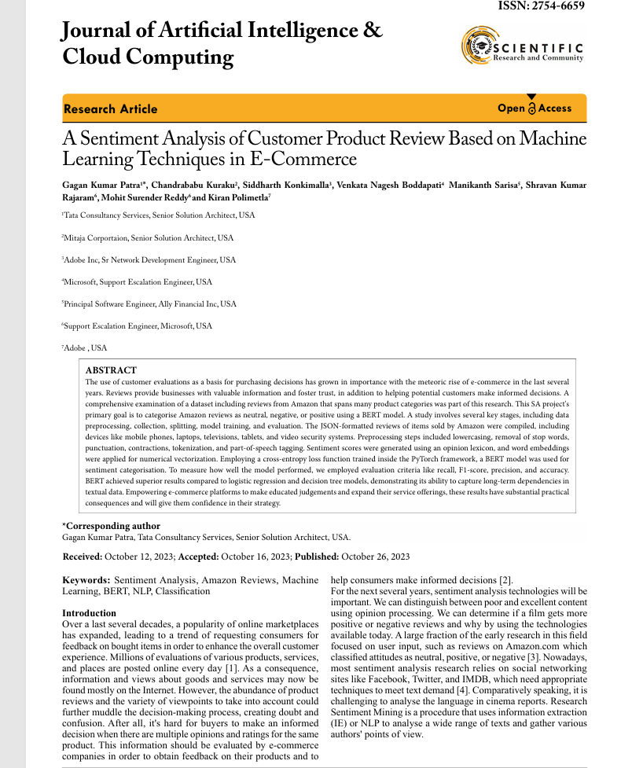
LITERATURE SURVEY
DESCRIPTION
Sentiment analysis (SA) is used to identify and extract subjective information in source materials
The Opinion Mining and Sentiment Analysis (OMSA) is used to process a set of search results for a given item, generate a list of product attributes (quality, features etc.), and to aggregate opinions. The aim of this study is to use context analysis to classify text in social media.
The aim of this study is to use context analysis to classify text in social media.
In this study, customer reviews of products were examined, and the polarity of the reviews was determined by considering the customers‟ various language features
Both negative and positive reviews were collected from amazon web sites.

Slide 6
PROPOSED SYSTEM
The system processes user comments to detect sentiments by Sentiment Detection
Improves products or Services based on customer feedback.
Identifying sentiments towards specific aspects or entities mentioned in the text by usingAspect-Based Sentiment Analysis
Visualize sentiment trends over time using tools like Matplotlib, or custom web-based dashboards.

Slide 7
SYSTEM REQUIREMENTS
Software Requirements
Windows 10
Visual Studios 2022
Core Components:
Data Cleaning and Preprocessing Tools:
Natural Language Processing (NLP) libraries (NLTK, spaCy)
Sentiment Analysis Libraries:
Machine learning frameworks (Scikit-learn, TensorFlow, PyTorch)
Data Visualization Tools:
Matplotlib,
Seaborn
Database Management System
MySQL
Hardware Requirements
Processor : i5
ROM:1TB
Memory : 8GB RAM
OS:Microsoft Windows 10/11

Slide 8
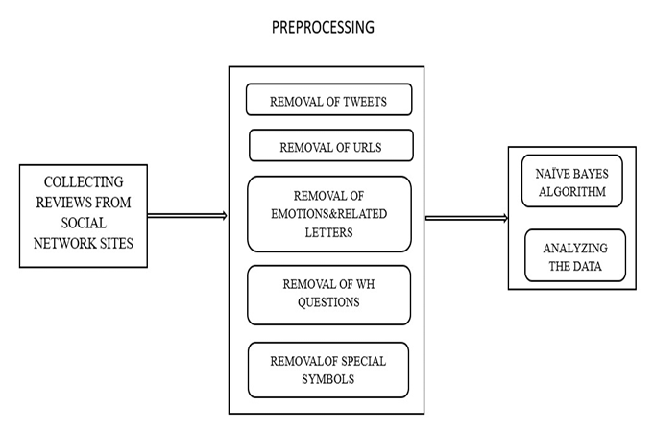
SYSTEM ARCHITECTURE

Slide 9
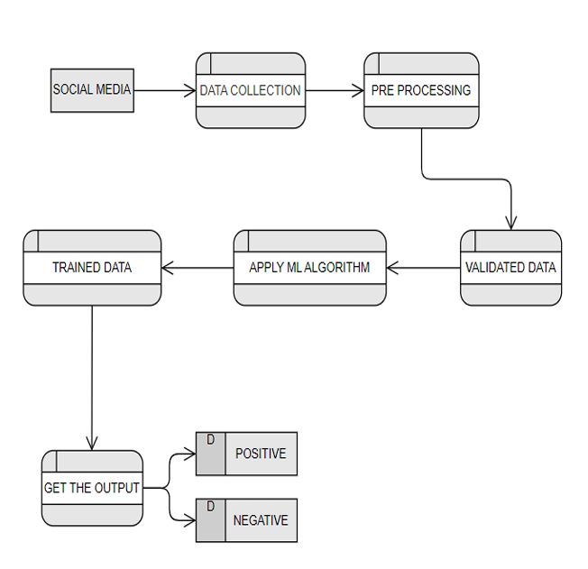
UML DIAGRAM
DATA FLOW DIAGRAM

Slide 10
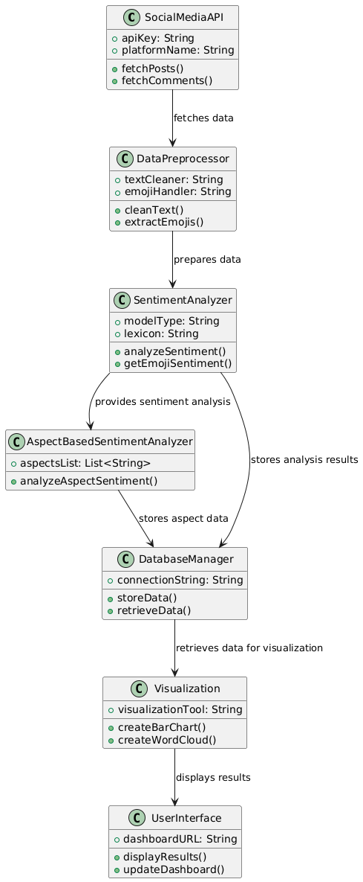
CLASS DIAGRAM

Slide 11
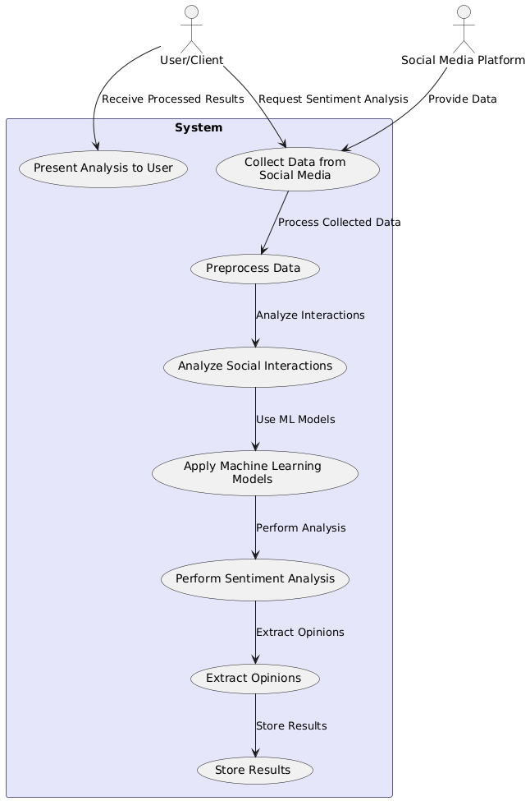
USE CASE DIAGRAM

Slide 12
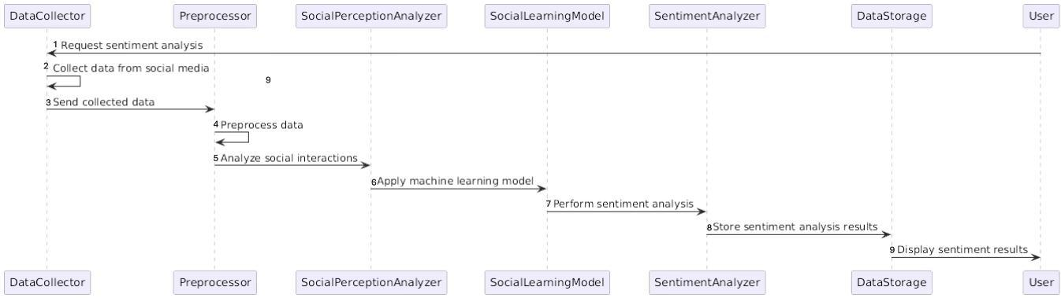
SEQUENCE DIAGRAM

Slide 13
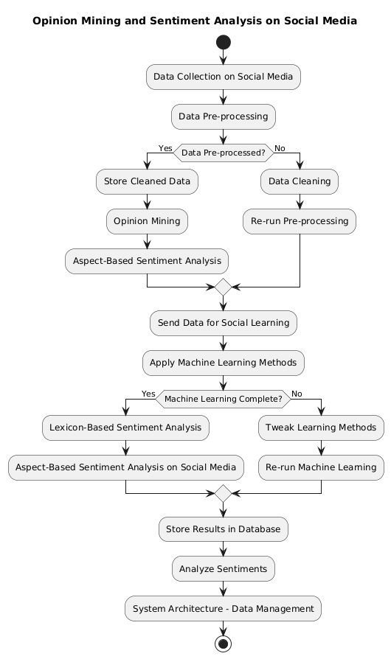
ACTIVITY DIAGRAM

Slide 14
THANK YOU

